Slide 1


3905 Century Club Net
by Claus Niesen
April 2nd, 2020
Story County Amateur Radio Club

Slide 2
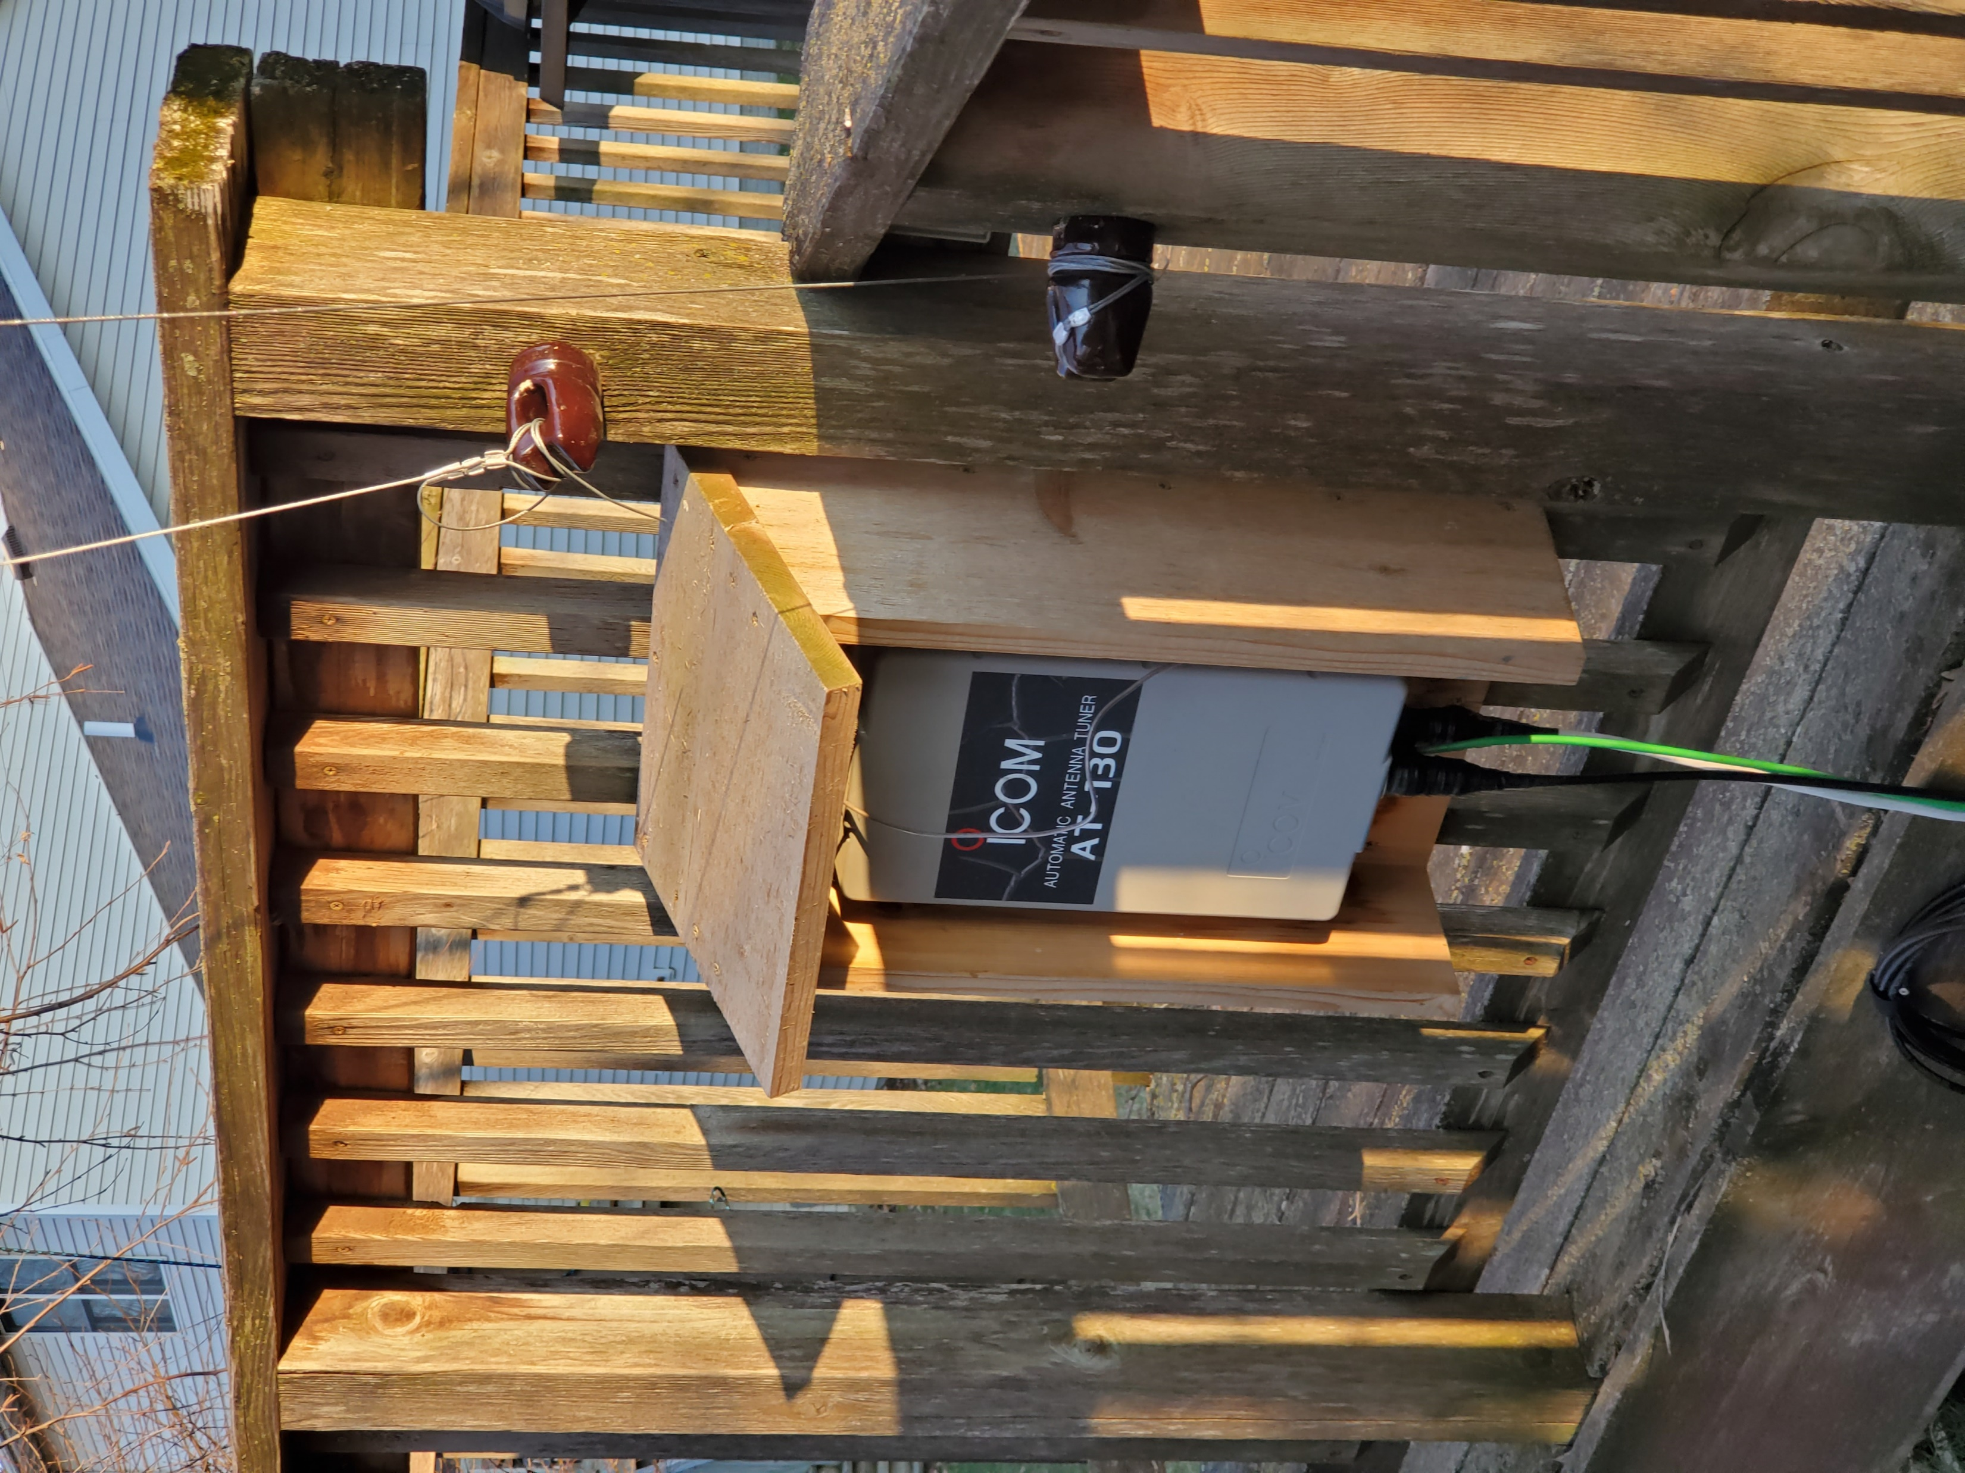
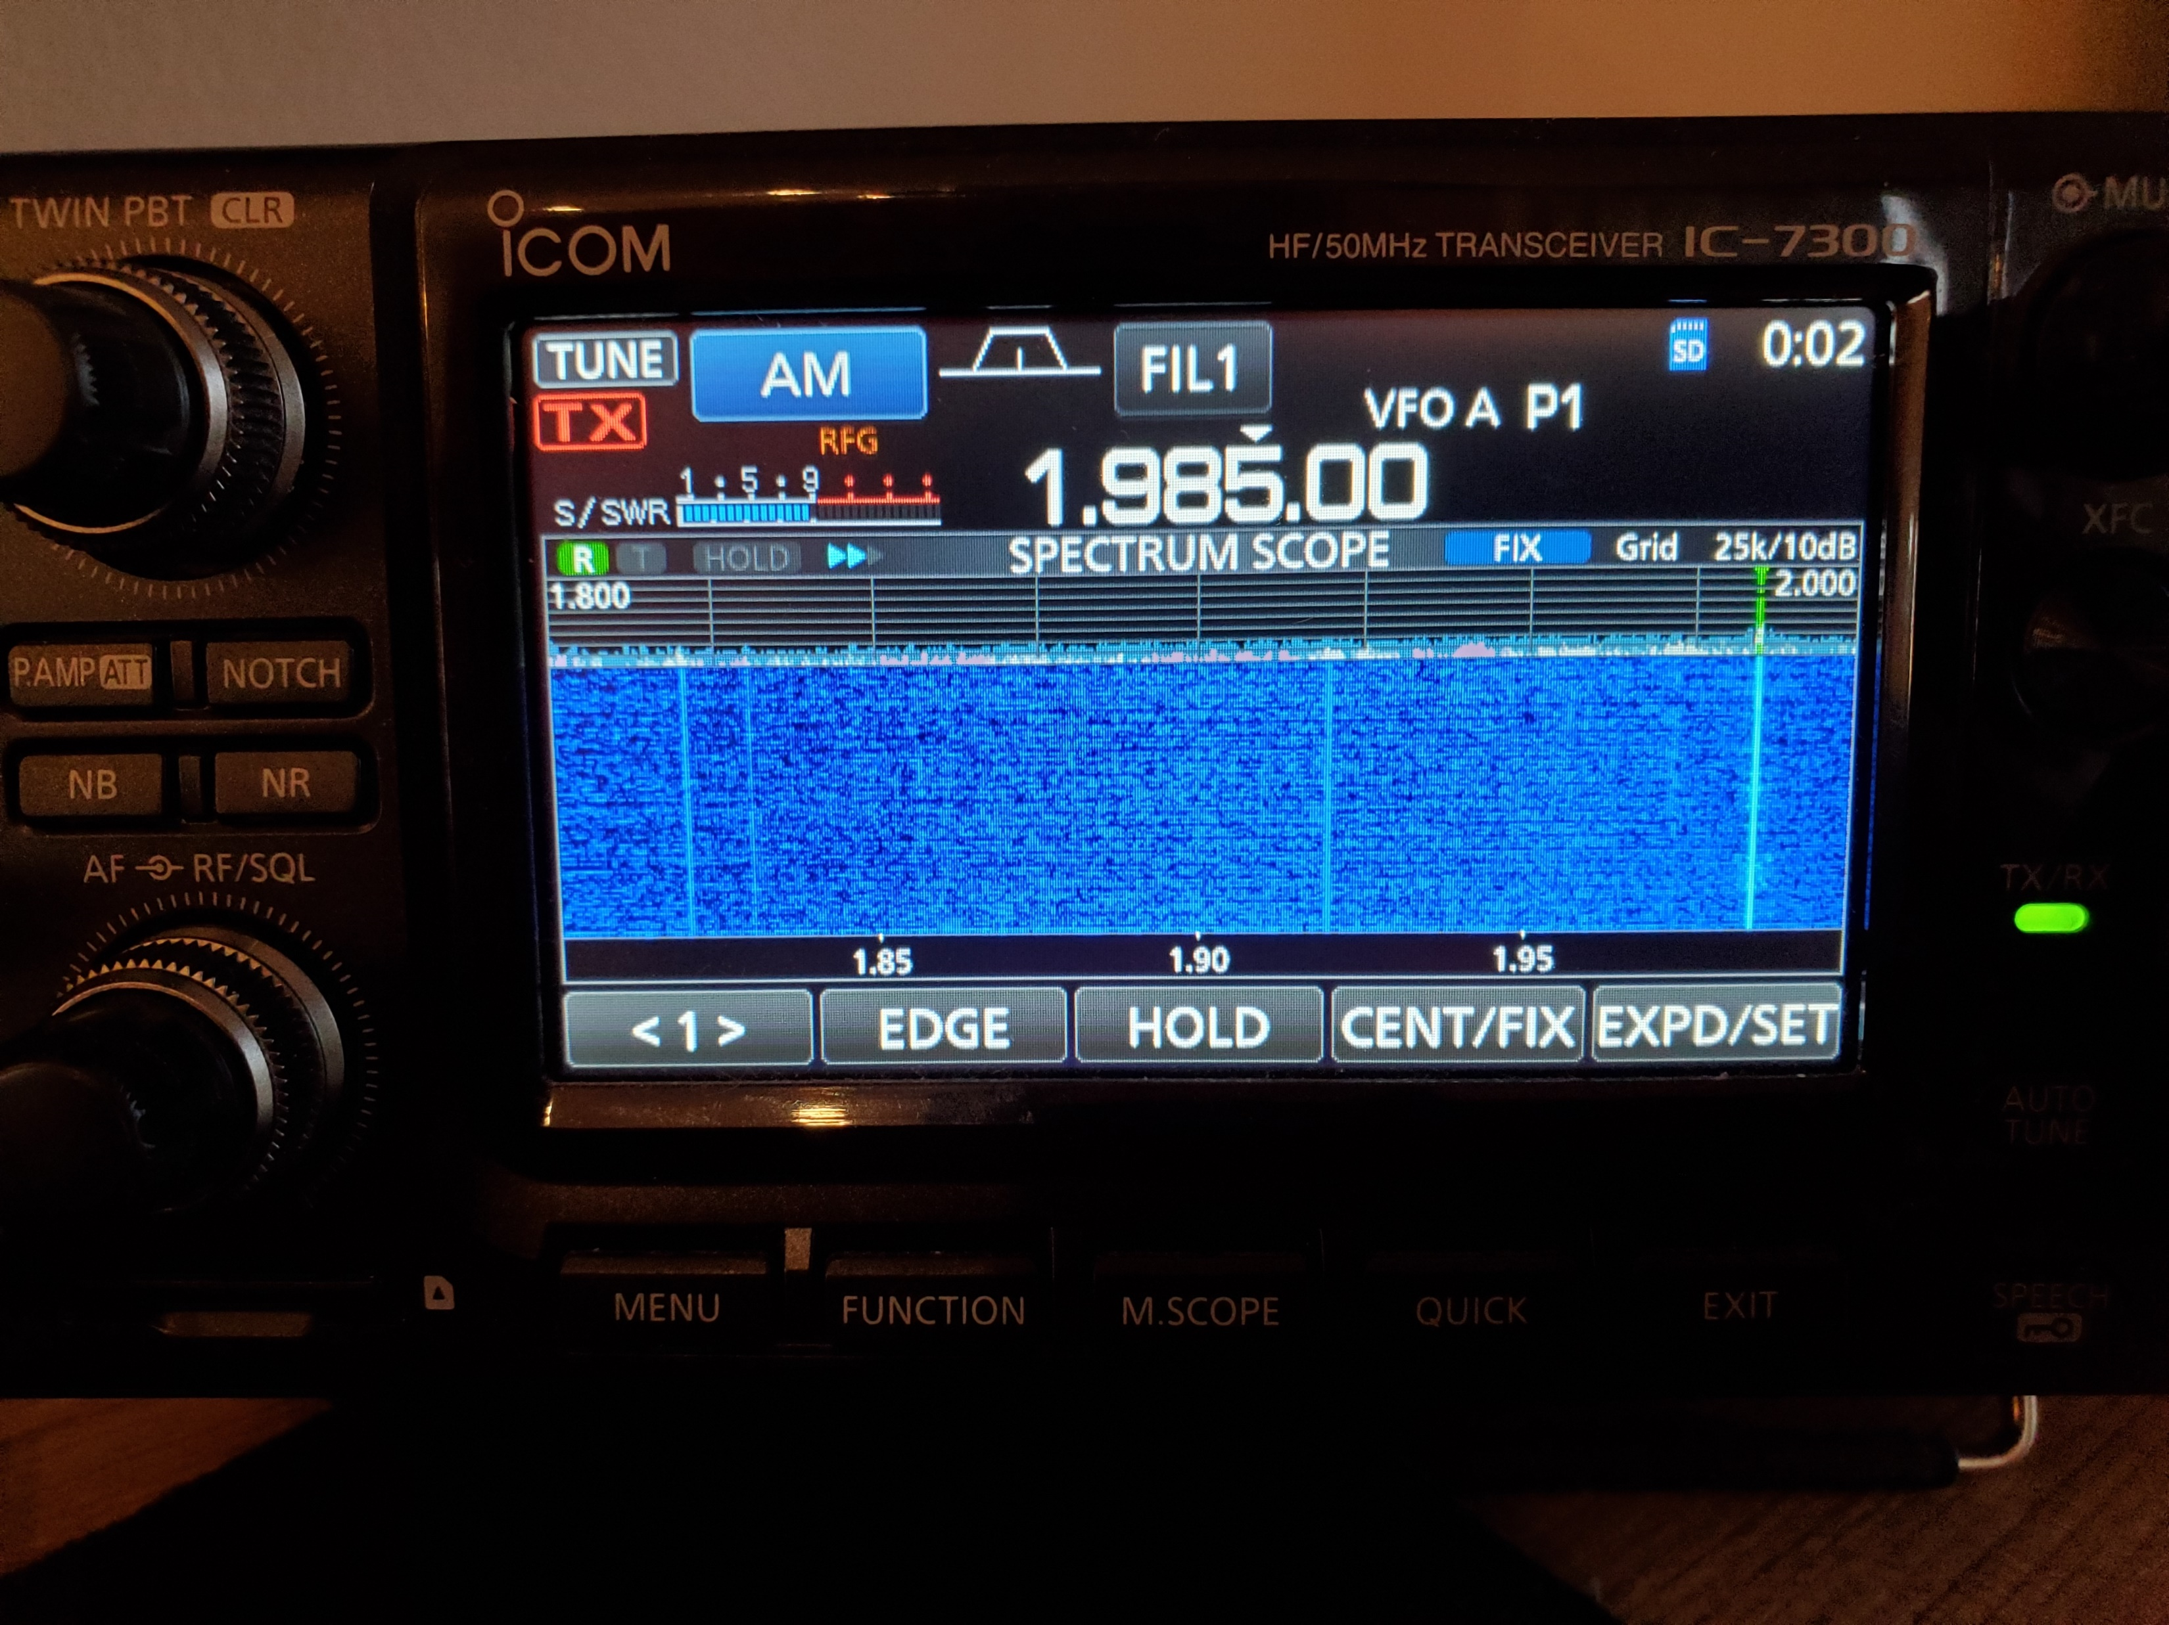
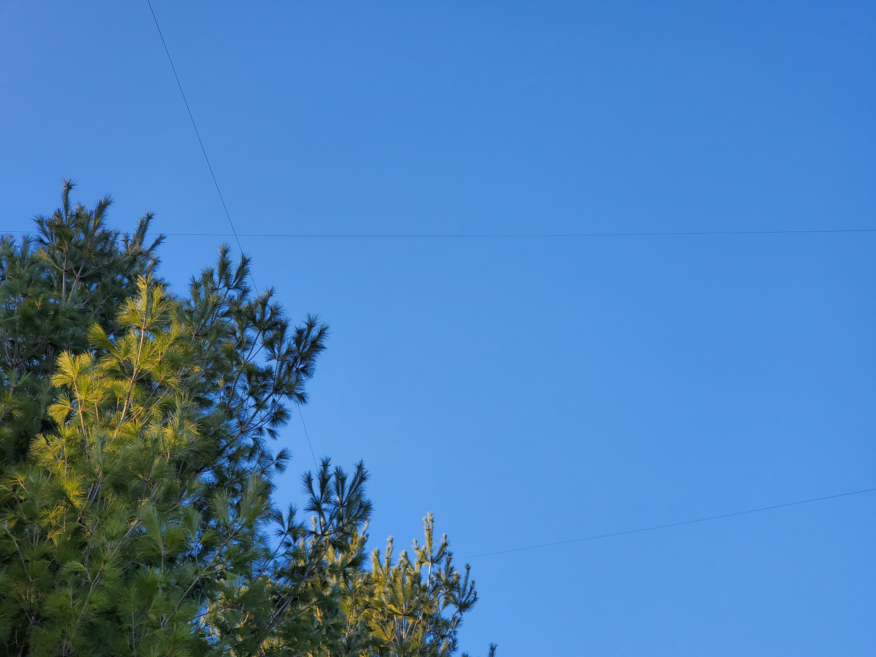
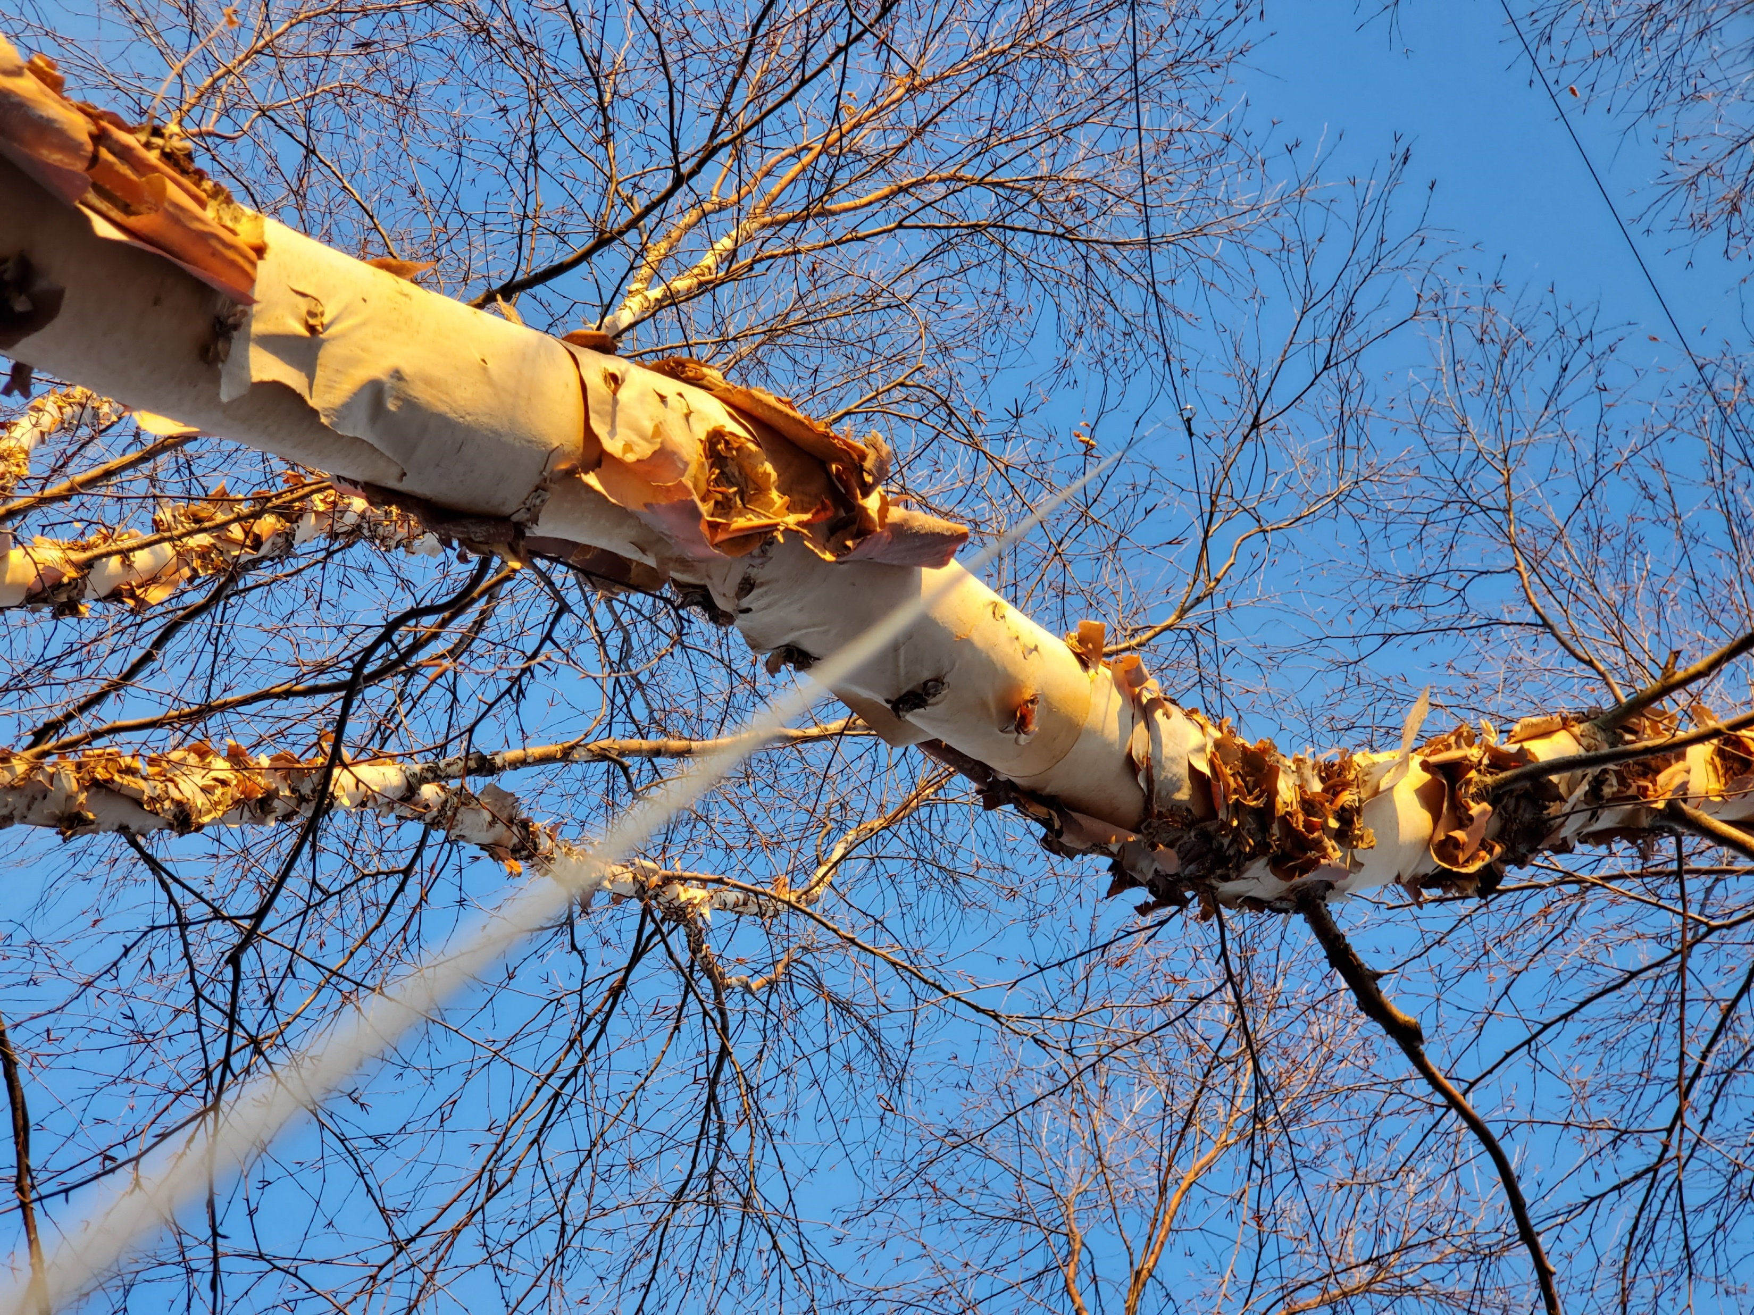
160m
desire

Slide 3
3905 Century Club
Founded February 7, 1977
Primary Purpose: Make contacts and exchange QSL cards
Nets on 20, 40, 80 and 160m bands
Modes: SSB, CW, RTTY and PSK31
Schedule:
http://www.3905ccn.com/netsched.htm

Slide 4
3905 Net
Pre check-ins (before net start time)
Announcements
Check-ins by call area (DX, 1, 2, …, 9, 0)
Each station is assigned a line number on the list
Run through the list – each station can:
Make a call to another station
“up for grasps”, invitation for other station to call you
“take a pass”, skip your turn
Closing announcements

Slide 5
QSO
Calling line # 14 W0YL from AE0S, do you copy?
W0YL this is AE0S, last heard you where 45.
AE0S, you are 33
AE0S, thanks for the 45, you are also 45. W0YL
Thanks for the 33, you are 21, 21, 2x1, minimum minimum, copy?
QSL the 45, thanks for the contact.
(NC) That’s a good call. #16 W0YR, Paul your call.

Slide 6
Sending Numbers
22, 2x2 (two-by-two)
Alternates:
21 – minimum
22 – rifle shot
33 – triple triple
59 – maximum

Slide 7
The manly List
Paper list:
# | Call | State | Sent | Received
1 | K7TOP | OK | 0
2 me | AE0S |  | - | -
..
14 | W0YL | IA | 45 | 45
15 checked out
16 | AC2MT | NY | 47

Slide 8
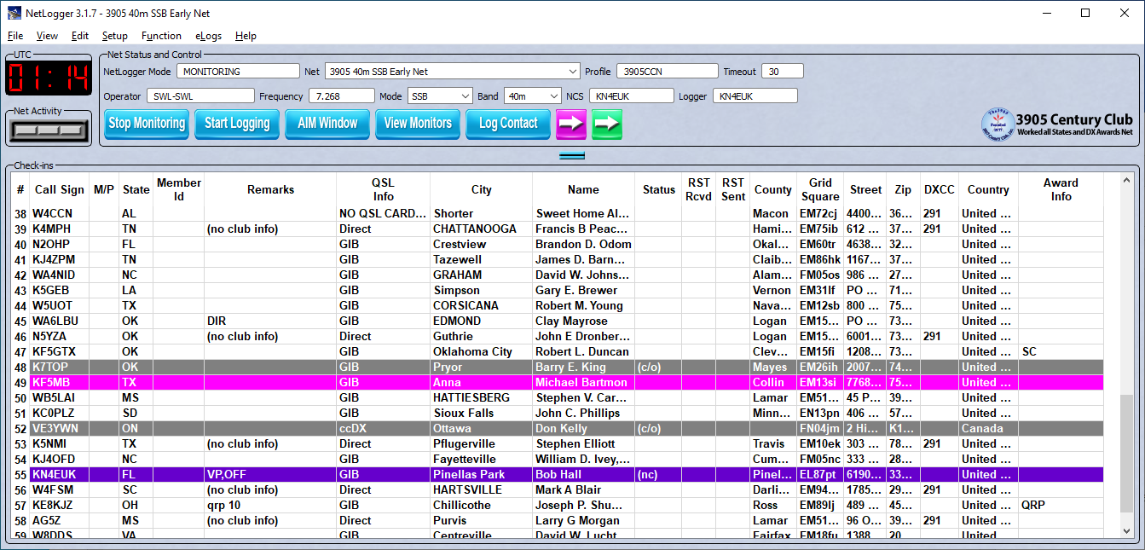
NetLogger
Windows, Mac, and Linux https://www.netlogger.org/

Slide 9
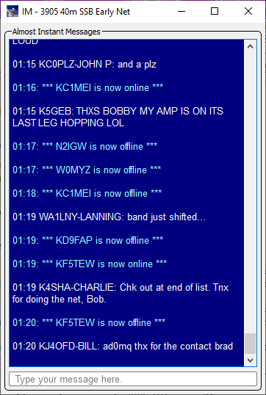
NetLogger – Almost Instant Messages (AIM)
Can’t assist with QSOs
For side chats
Checkouts if it’s not your turn or calls for check-ins
Optional

Slide 10
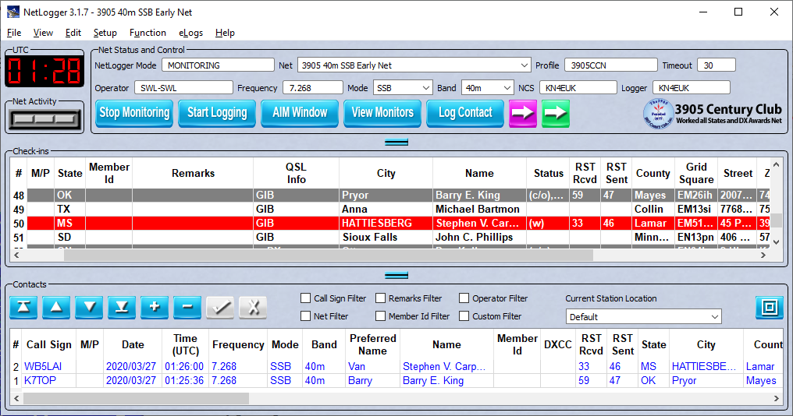
NetLogger - Contacts
Exports: ADIF, CSV

Slide 11
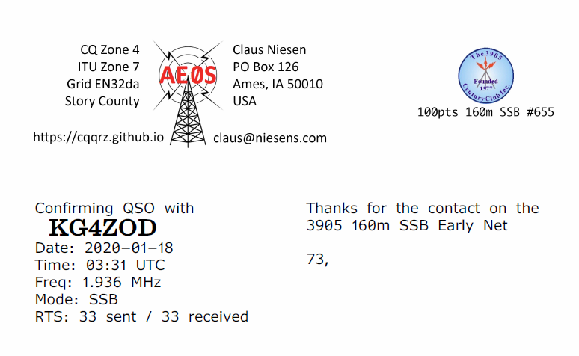
NetLoggerElf (extreme alpha software)
Java command line app
Reads LetLogger CSV
Prints QSL cards to PDF
Inserts QSOs into Log4OM
https://github.com/cniesen/NetLoggerElf

Slide 12
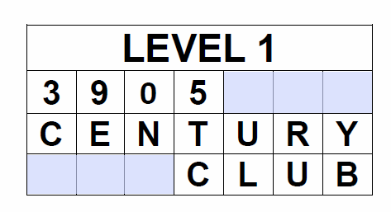
3905 Awards
Nearly 50 awards
Main award 100, 500, 1000, 2000 points series
eg Crossword Puzzle
eg Baker’s Dozen – contact same mobile/portable in 13 US states
Master award (prestigious)

Slide 13
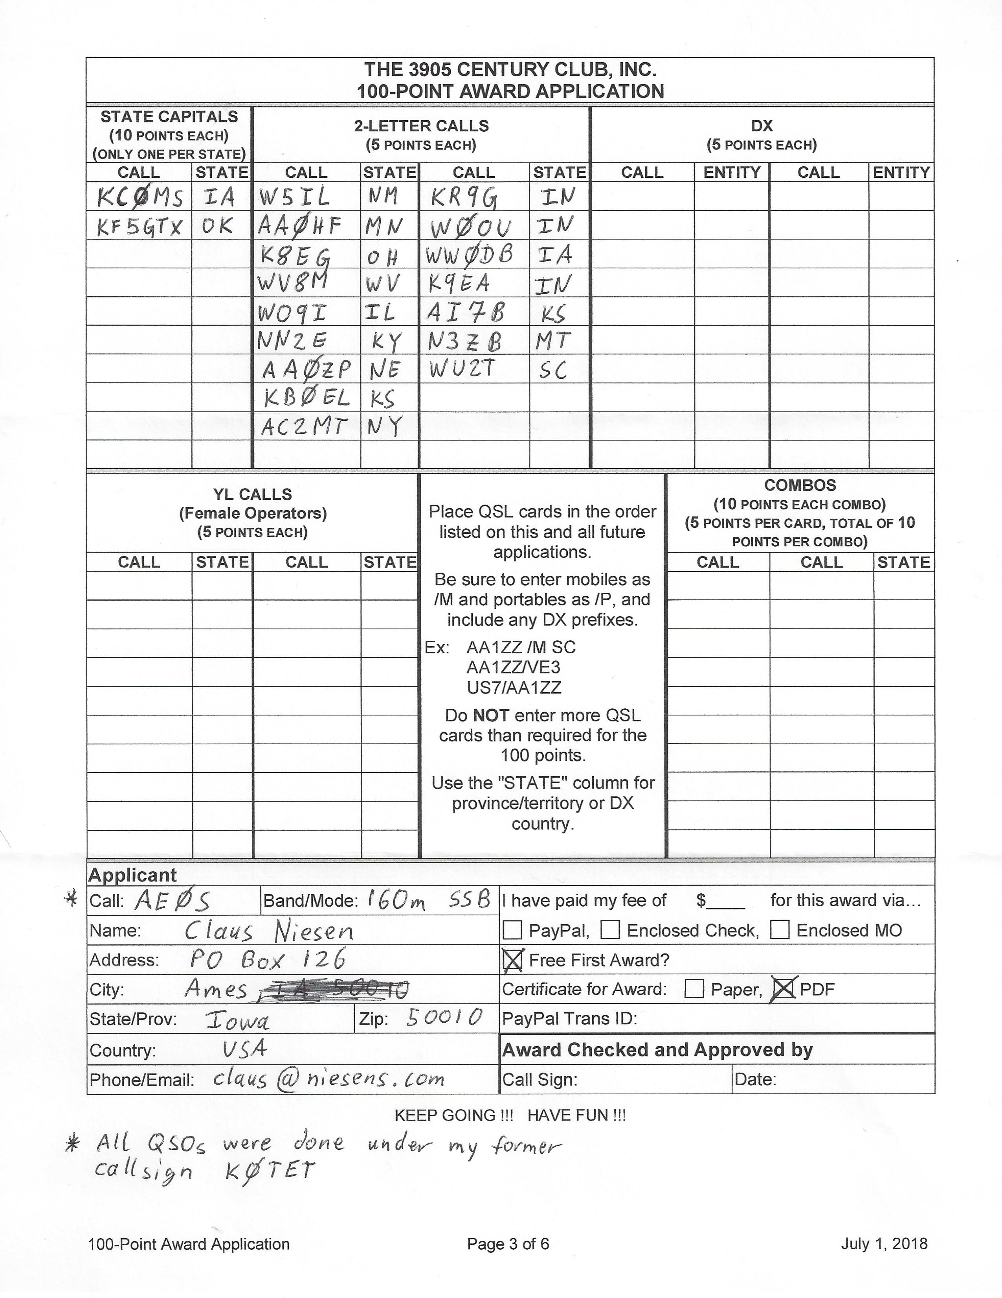
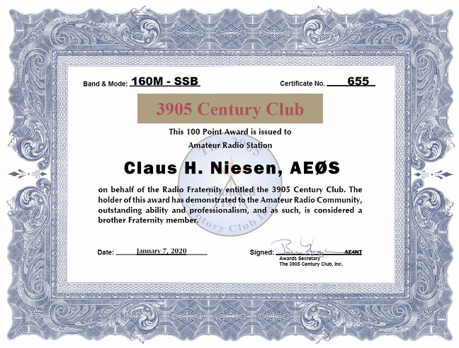
My 1st Award

Slide 14
3905 Awards
First award must be a 100 Point Award and is free
Awards are $4/$3 for paper or $2 PDF.
All contacts must be made via the 3905 CC Nets.
Paper SQL and eSQL accepted.

Slide 15
3905 Bureau
Very fast, very economical
Totally different than ARRL DX Bureau
Only for 3905 Net contacts
No need to be a member (have 100 Point Certificate)
Just use it!

Slide 16
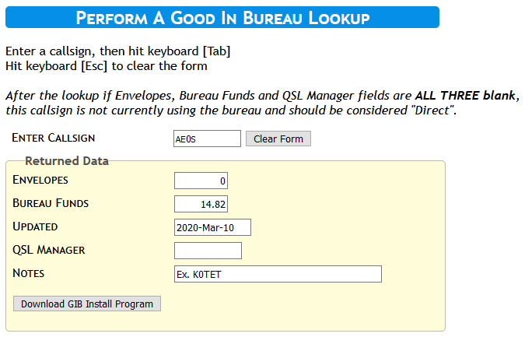
Good In Bureau (GIB)
https://3905ccn.hamshackonline.net/bureau/bureau.php
Enter call
Press tab
Press enter and repeat

Slide 17
3905 QSL Bureaus
All Nets – outbound and inbound QSL
DX QSL Bureau – for outbound cards to non US stations/addresses
Handiham QSL Service – for disabled operators, provides additional services

Slide 18
Bureau Account Options
Envelopes
Why?
Account Balance
Check
PayPal (fees apply)
Cost: postage + $0.19 for envelope

Slide 19
Bureau
Sort card by call area of recipient’s call sign (1,2, …, 9, 0)
Don’t use photo paper (they stick together)
Keep QSO info on one side (avoids having to flip card when sorting)
Club cards need operator’s callsign

Slide 20
Net Control Operators
Formal training, exam and certificate.
Net Control Station awards
http://www.3905ccn.com/ncsinfo.htm

Slide 21
Club Politics
Officer’s elected for 2 years
Election every year of half the board. Need 100pts Award to vote.
QSOs with officers may be helpful for some awards.
http://www.3905ccn.com/officers.htm

Slide 22
Centurion Newsletter
About quarterly news letter
Color PDF decent size and content
Available online
http://www.3905ccn.com/files/pdf/centurion-current.pdf

Slide 23
Annual Eyeball
5 day meeting in the summer
Presentations
Socializing
Mobile Shootout
About 50 attendees
July 15-19, 2020 Louisville MS
https://eyeball2020.com

Slide 24
Group.io Mailing Lists
General Chat https://groups.io/g/3905Chatgp
Award Discussions https://groups.io/g/3905AwdTalk
Check-in list and real time net related https://groups.io/g/3905Checkins
Net control Stations https://groups.io/g/3905ccnNCS

Slide 25

Time to
ask questions
and
hope for answers

